Slide 1

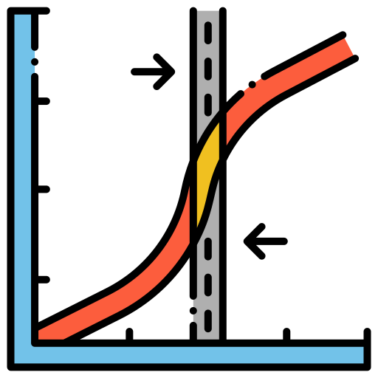
LEAD SCORING CASE STUDY ON LOGISTIC REGRESSION by Vaibhav & Lalkrishna DSC43 Batch

Slide 2

Problem Statement
An X Education need help to select the most promising leads, i.e., the leads that are most likely to convert into paying customers. The company requires us to build a model wherein you need to assign a lead score to each of the leads such that the customers with higher lead score have a higher conversion chance and the customers with lower lead score have a lower conversion chance. The CEO has given a ballpark of the target lead conversion rate to be around 80%.

Slide 3

Goals of Case study
Build a logistic regression model to assign a lead score between 0 and 100 to each of the leads which can be used by the company to target potential leads. A higher score would mean that the lead is hot, i.e., is most likely to convert whereas a lower score would mean that the lead is cold and will mostly not get converted

Slide 4
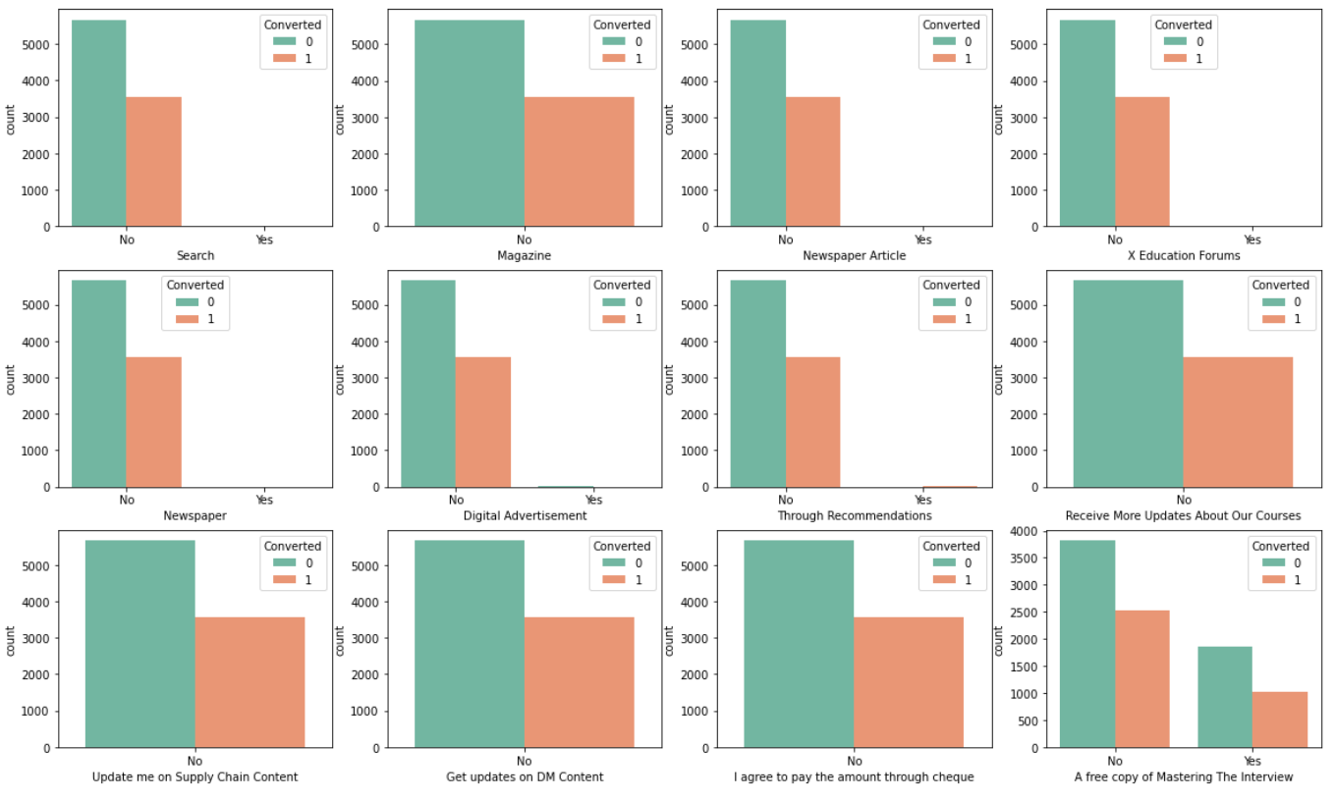
Categorical Attributes Analysis
Inference
For all these columns except 'A free copy of Mastering The Interview' data is highly imbalanced, thus we will drop them
"A free copy of Mastering The Interview" is a redundant variable so we will include this also in list of dropping columns

Slide 5
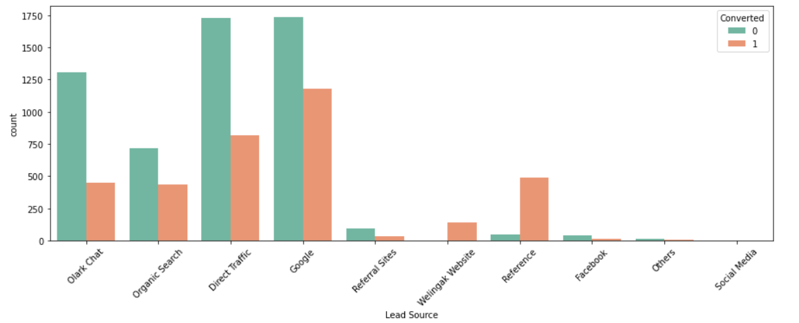
Visualizing count of Lead Source Variable based on Converted value
Inference
Maximum Leads are generated by Google and Direct Traffic.
Conversion rate of Reference leads and Welinkgak Website leads is very high.

Slide 6
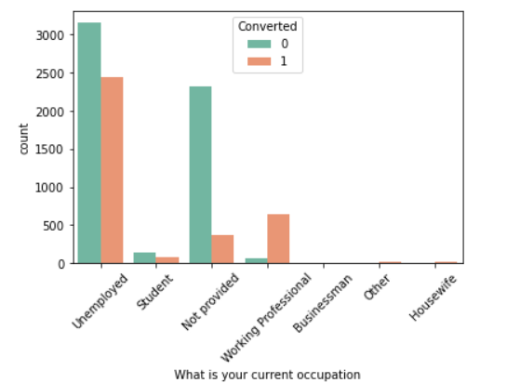
Visualizing count of Variable based on Converted value
Inference
Maximum leads generated are unemployed and their conversion rate is more than 50%.
Conversion rate of working professionals is very high.

Slide 7
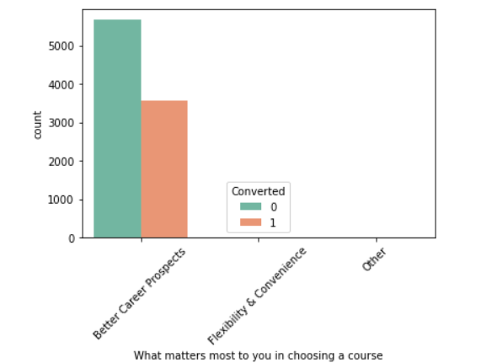
What matters most to you in choosing a course
Inference This column spread of variance is very low , hence it can be dropped.

Slide 8
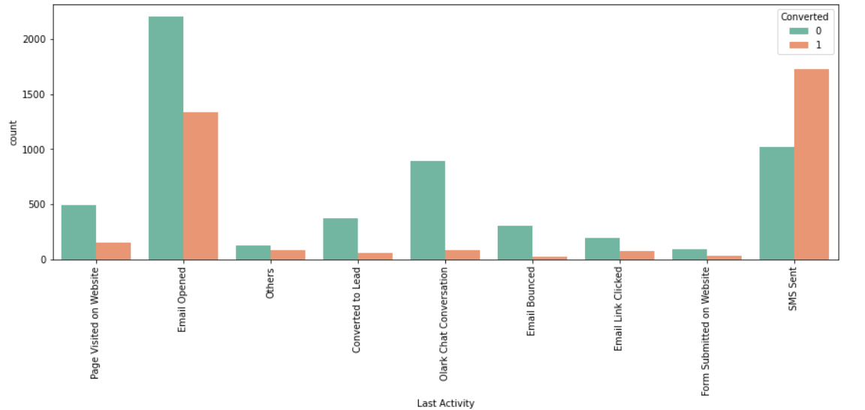
Visualizing count of Last Activity variable
Inference
Maximum leads are generated having last activity as Email opened but conversion rate is not too good.
SMS sent as last activity has high conversion rate.

Slide 9
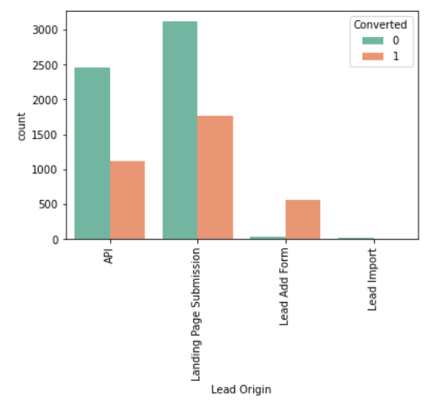
Visualizing count of Lead Origin variable

Slide 10
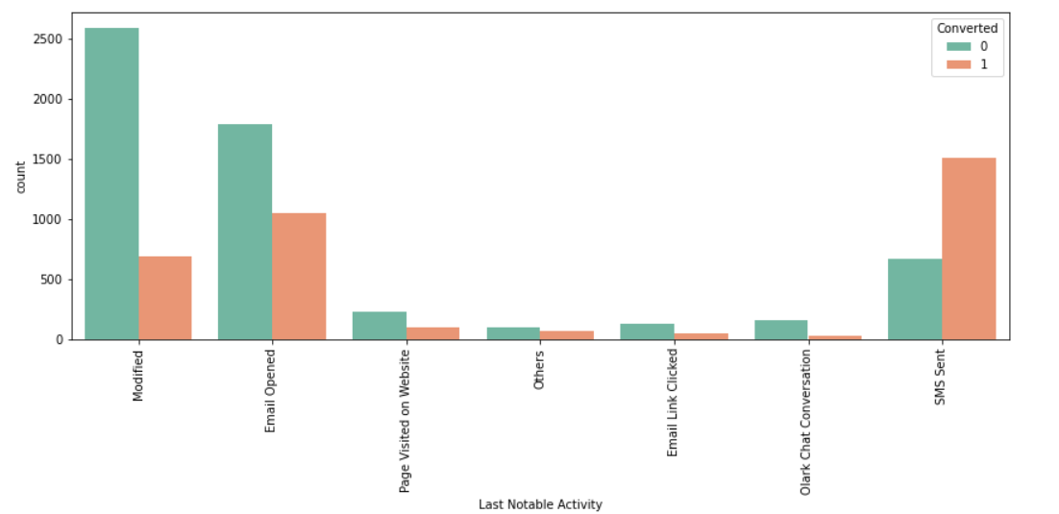
Visualizing count of Last Notable ActivityVariable based on Converted value
Inference
Maximum leads are generated having last activity as Email opened but conversion rate is not too good.
SMS sent as last activity has high conversion rate.

Slide 11

Numerical Attributes Analysis:

Slide 12
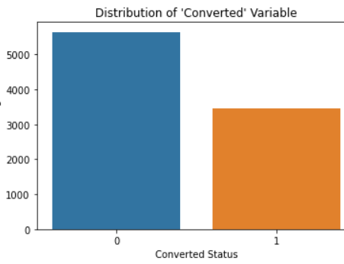
Visualizing Distribution of 'Converted' Variable
Inferences
Currently, lead Conversion rate is 38% only

Slide 13
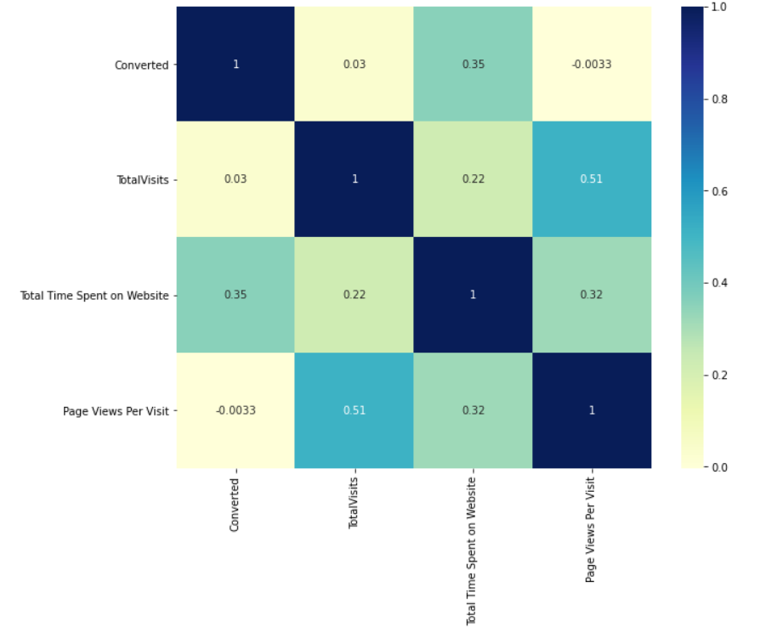
Correlations of numeric values using heatmap

Slide 14
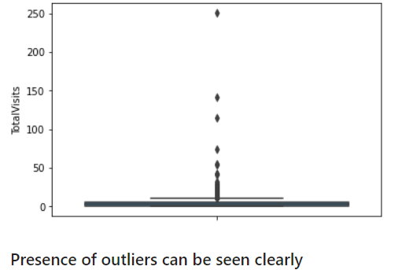
Visualizing spread of variable Total Visits

Slide 15
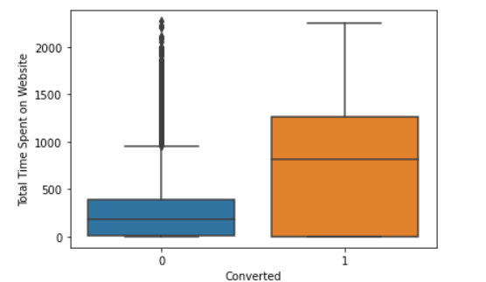
Inferences on Total time spent on website
Inference
As can be seen, leads spending more time on website are more likely to convert , thus website should be made more engaging to increase conversion rate

Slide 16
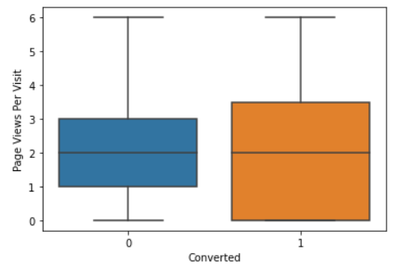
Visualizing 'Page Views Per Visit’ Target variable 'Converted'
Inference
Median for converted and not converted leads is almost same.
Nothing conclusive can be said based on Page Views Per Visit.

Slide 17
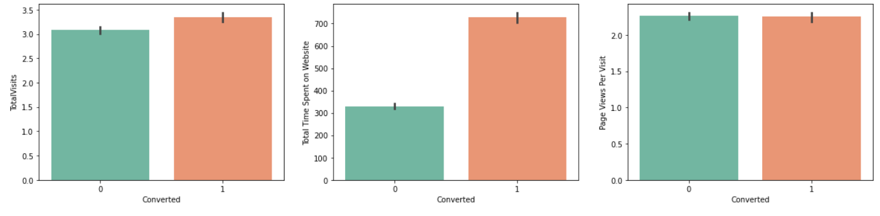
Conversions for all numeric values
Inference The conversion rate is high for Total Visits, Total Time Spent on Website and Page Views Per Visit
Now, all data labels are in good shape , we will proceed to our next step which is Data Preparation

Slide 18
Data Preparation
Converting some binary variables (Yes/No) to 0/1
Dummy Variable Creation
Test-Train Split
Feature Scaling using Standard scaler

Slide 19
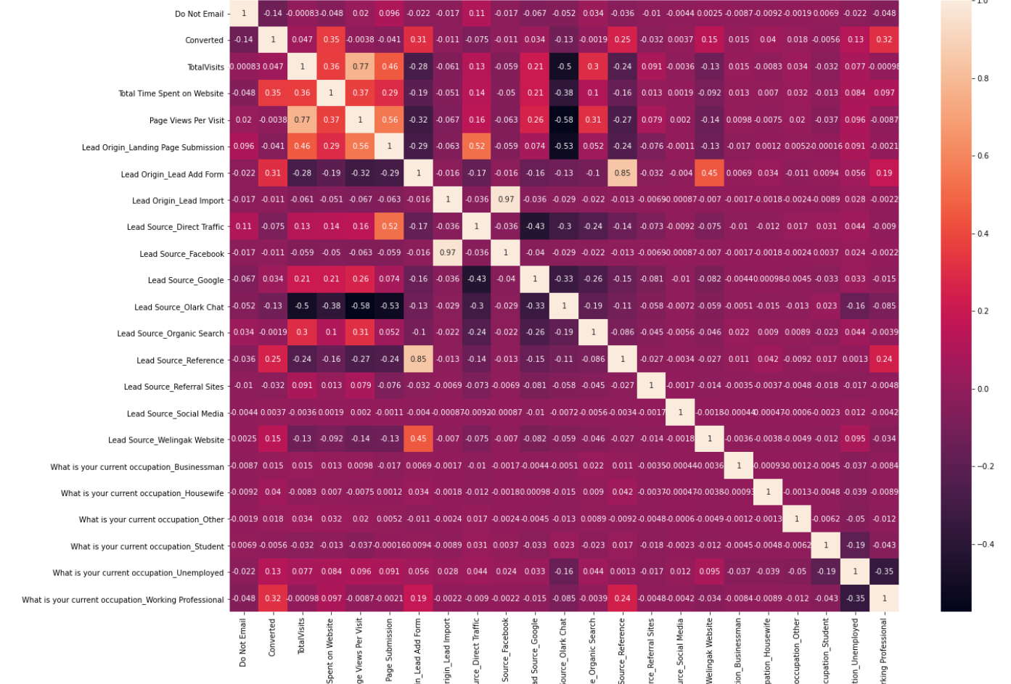
Correlation matrix
Dropping highly correlated dummy variables

Slide 20

Model Building using Stats Model & RFE

Slide 21
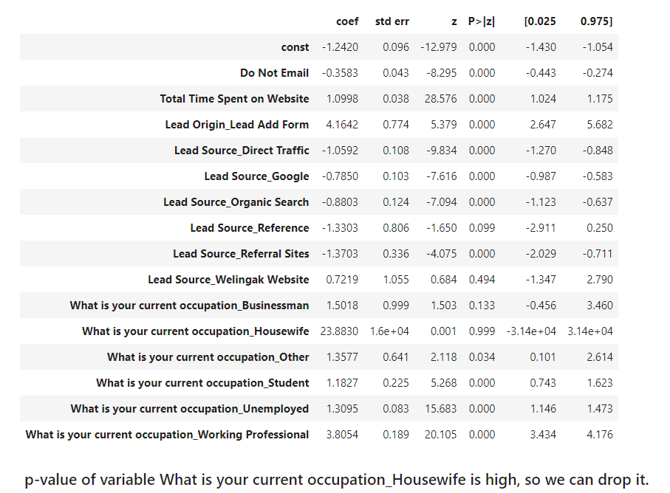
Model 1 Results
Inference :
p-value of variable What is your current occupation Housewife is high, so we can drop it.

Slide 22
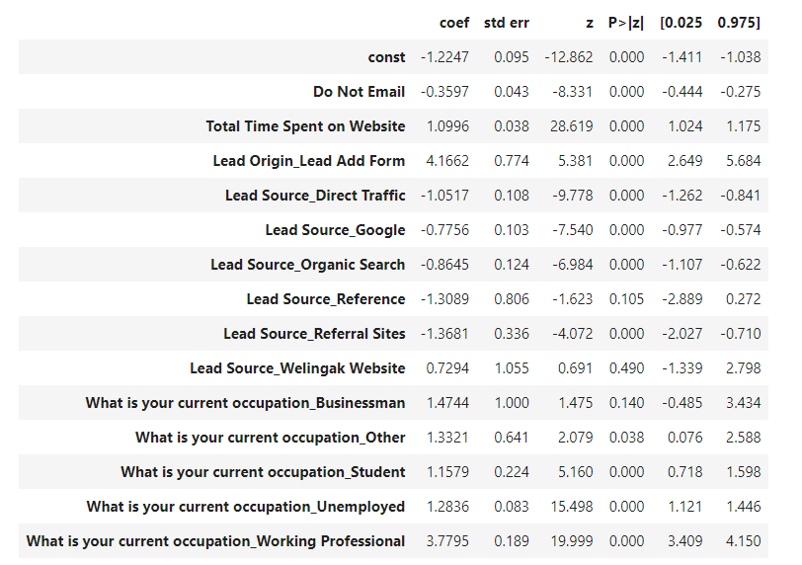
Model 2 results
Inference :-
p-value of variable "Lead Source Welingak Website" is high, so we will drop it.

Slide 23
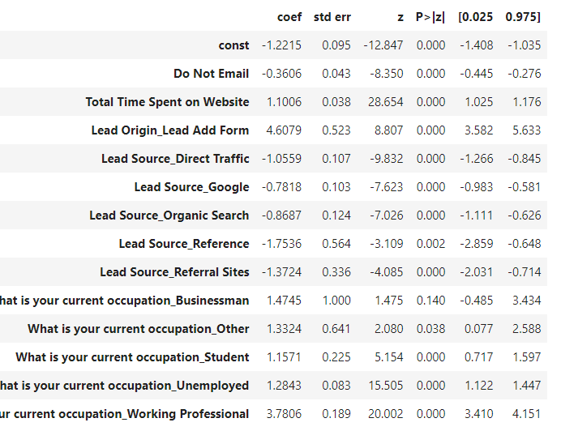
Model 3 Results
Inference :-
variable 'What is your current occupation Businessman' has high p-value, so it needs to be dropped

Slide 24
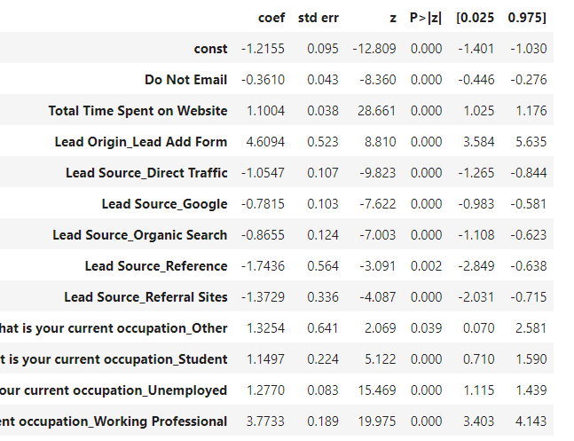
Model 4 results
Inference :-
No such changes observed

Slide 25
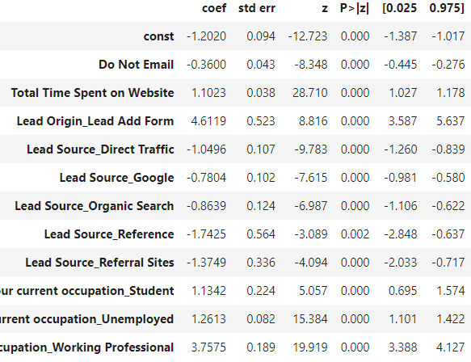
Model 5 Results
Inference :-
Since the Model 5 seems to be stable with significant p-values, we shall go ahead with this model for further analysis

Slide 26
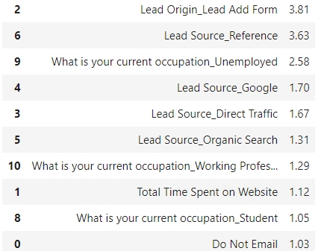
Calculating VIF (variance inflation factor)
Observation:-
All variables have a good value of VIF. So, we need not drop any more variables and we can proceed with making predictions using this model only

Slide 27
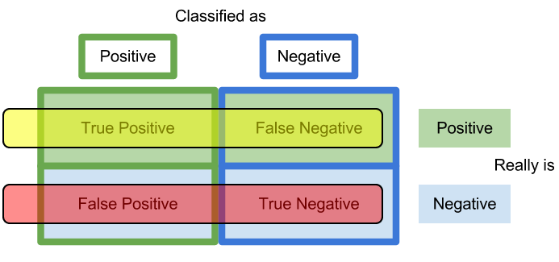
Predicting a Train model
Observations :-
Accuracy Level = 80 %
Sensitivity Level = 65%
Specificity Level = 90%

Slide 28
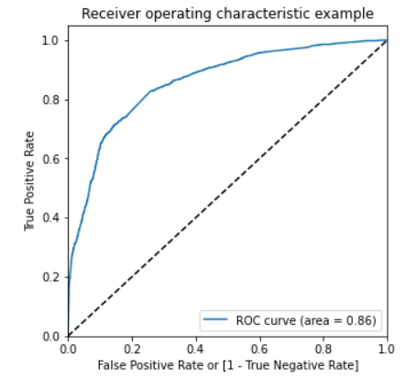
PLOTTING ROC CURVE
An ROC curve demonstrates several things:
It shows the tradeoff between sensitivity and specificity (any increase in sensitivity will be accompanied by a decrease in specificity).
The closer the curve follows the left-hand border and then the top border of the ROC space, the more accurate the test.
The closer the curve comes to the 45-degree diagonal of the ROC space, the less accurate the test.
The ROC Curve should be a value close to 1. We are getting a good value of 0.86 indicating a good predictive model.

Slide 29
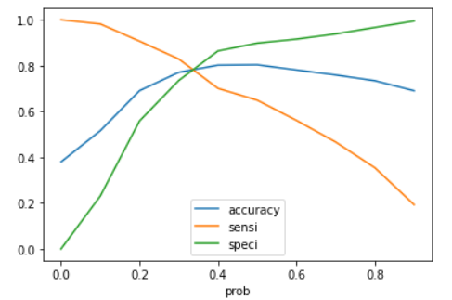
Finding Optimal Cut off Point
Optimal cutoff probability is that prob where we get balanced sensitivity and specificity
From the curve above, 0.3 is the optimum point to take it as a cutoff probability.

Slide 30

Percentage of final predicted conversions
Hence, we can see that the final prediction of conversions have a target of 83% conversion as per the X Educations CEO's requirement . Hence, we can say that this is a good model.
Overall Metrics - Accuracy, Confusion Metrics, Sensitivity, Specificity, False Positive Rate, Positive Predictive Value, Negative Predictive Value on final prediction on train set
Inference: So, as we can see above the model seems to be performing well. The ROC curve has a value of 0.86, which is very good. We have the following values for the Train Data:
Accuracy : 77.05%
Sensitivity :82.89%
Specificity : 73.49%

Slide 31
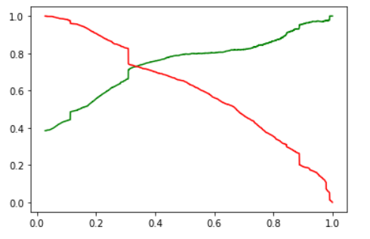
Precision and Recall Trade-off
Scores:-
Precision:- 65 %
Recall :- 82 %

Slide 32
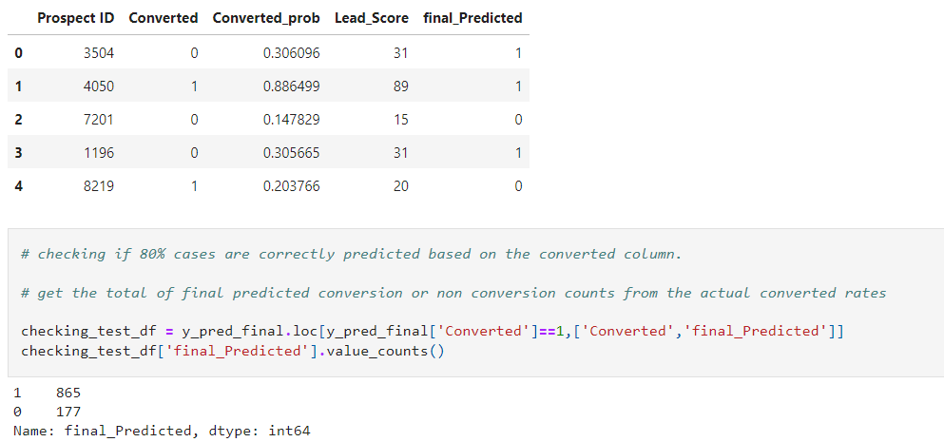
Percentage of final predicted conversions on test data
Hence, we can see that the final prediction of conversions have a target rate of 83% (same as predictions made on training data set)

Slide 33

Overall Metrics on Test Dataset
Accuracy = 77 %
Sensitivity = 83%
Specificity = 74%
Precision = 66%
Recall = 83 %

Slide 34
Conclusion
While we have checked both Sensitivity-Specificity as well as Precision and Recall Metrics, we have considered the optimal cut off based on Sensitivity and Specificity for calculating the final prediction.
Accuracy, Sensitivity and Specificity values of test set are around 77%, 83% and 74% which are approximately closer to the respective values calculated using trained set.
Also, the lead score calculated in the trained set of data shows the conversion rate on the final predicted model is around 80%
Hence overall this model seems to be good.

Slide 35
Important features responsible for good conversion rate or the ones' which contributes more towards the probability of a lead getting converted are :
Lead Origin_Lead Add Form
What is your current occupation_Working Professional
Total Time Spent on Website

Slide 36
Thank you

